Slide 1
LESSON 1
Good Programming Practices
CSC 300
Fall 2026
Howard Rosenthal

Slide 2
Course References
Materials for this course have utilized materials in the following documents. Additional materials taken from web sites will be referenced when utilized.
http://www.programmedlessons.org/Java9/index.html
Anderson, Julie and Franceschi, Herve, Java Illuminated 5TH Edition,, Jones and Bartlett, 2019
Bravaco, Ralph and Simonson, Shai, Java Programming From The Ground Up, McGraw Hill, 2010
Deitel, Paul and Deitel, Harvey, Java, How To Program, Early Objects, Eleventh Edition, Pearson Publishing, 2018
Gaddis, Tony, Starting Out With Objects From Control Structures Through Objects, Seventh Edition, Pearson Publishing, 2019
Horstmann, Cay, Core Java For The Impatient, Addison Wesley- Pearson Education, 2015
Lecessi, Ralph, Functional Interfaces In Java, Apress, 2019
Naftalin, Maurice and Wadler, Philip, Java Generics and Collections, O’Reilly Media, 2007
Schmuller, Joseph, Teach Yourself UML In 24 Hours Second Edition, SAMS Publishing, 2002
Urma, Raoul-Gabriel, Fusco, Mario and Mycroft, Alan, Java 8 in Action: Lambdas, Streams, and Functional-Style Programming, Manning Publishing, Second Edition 2019
Wirfs-Brock, Rebecca, Wilkerson, Brian and Wiener, Laura, Designing Object-Oriented Software, Prentice Hall, 1990
Oracle On-Line Documentation and Tutorials, https://docs.oracle.com

Slide 3
Links
https://howtodoinjava.com/java8/lambda-expressions/
https://www.javatpoint.com/java-8-method-reference
https://howtodoinjava.com/java8/lambda-method-references-example/
https://examples.javacodegeeks.com/java-functional-interface-example/
http://tutorials.jenkov.com/java-functional-programming/streams.html#java-stream-definition
https://howtodoinjava.com/java8/java-streams-by-examples/
Significant Portions of the following reference are used in this lesson:
Urma, Raoul-Gabriel, Fusco, Mario and Mycroft, Alan, Java 8 in Action: Lambdas, Streams, and Functional-Style Programming, Manning Publishing, Second Edition 2019

Slide 4
Lesson Goals
Project Management Approaches
Drivers in designing software
Discuss key software development practices
Describe good coding and testing practices
Describe Static Program Analysis
Describe Describe cyclomatic software complexity and how to calculate it
Describe imperative (object-oriented) versus declarative (Functional) programming

Slide 5
Purpose And Goals Of This Course (1)
The purpose of this class is to improve your programming skills
As Computer Science majors the professors in your upper division classes will expect you to be able to produce programs that solve the problems in many of their classes
In addition, many interviews for internships and full-time jobs include testing your programming skills and problem-solving approaches
Therefore, we want to teach you ways to improve your efficiency, your ability to design and then code and test the solutions to complex problems.

Slide 6
Purpose And Goals Of This Course (2)
Understanding basic object-oriented principles including inheritance, polymorphism and interfaces.
Learning how to read and use language documentation (in particular applied to Oracle documentation).
We will show you how to create and use generics
We will study Collections and the collection framework
We will learn some newer Java features including Lambdas, Functional Programming within Java, and if possible Streaming and Multitasking/Multithreading
The best online starting point is:
https://docs.oracle.com/en/java/javase/21/

Slide 7
Project Management Approaches

Slide 8
Project Management Types and Their Life Cycles
There are two different Project Management Types that employ different life cycle models
  Tradition Program Management (TPM) —Predictive and Iterative Life Cycle Models
    Used when the goal and solution are clear
    20% of all projects
    Example – Install a network in a building
  Agile Program Management – Incremental and Adaptive Life Cycles Models
    Used when the goal is clear but the solution is not
    Used when the final goal is changing so that the solution must evolve due to market changes, technological advancement, business needs, etc.
    80% of all projects
    Example – Send a crew of 5 to Mars and return them safely to Earth before 2030
      In the past a waterfall approach would be used, usually leading to massive cost over runs

Slide 9
Characteristics Of Agile Vs. Traditional Processes
Category | Agile | Traditional
Requirements | Assumes they will change; requirements are collected informally at the beginning of the project, and then at the beginning of each iteration. Uses constant user interaction instead of formal requirements. | Assumes they will not change during the project. A complete, detailed formal requirements document is necessary for success. Any changes in requirements after the design or implementation has started will be costly.
Planning | Not much planning up front. Planning done in small increments throughout development. | Most activities planned up front.
Scheduling | Only the next few activities are scheduled. Schedule may change if scope needs to be adjusted. | Schedules are relatively inflexible and should be adhered to.
Design | Informal and iterative. | Formal and done up front, after all requirements are known.
User Involvement | Crucial, frequent, throughout the whole process. | Required only at the beginning (requirements solicitation and analysis) and at the end (acceptance testing).
Documentation | Minimal, only what is necessary; relies on source code as the ultimate documentation. | Usually requires heavy, formal documentation of every phase of the project.
Communication | Continual with stakeholders | Periodic with management and sponsors

Slide 10
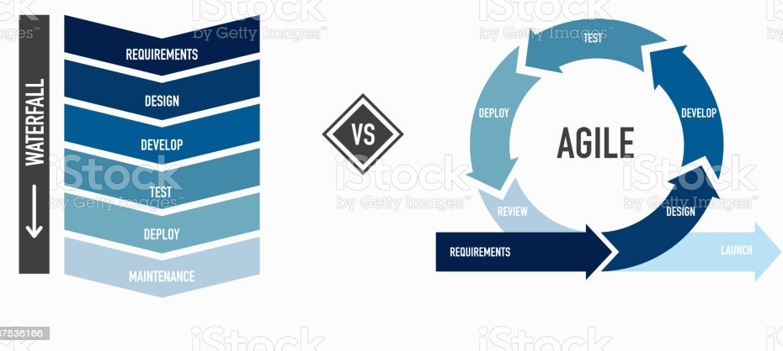
Waterfall vs. Agile

Slide 11
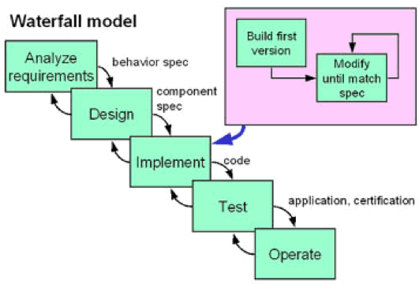
The Waterfall In Reality
In reality there are almost always unknowns and changes
This leads to the potential to circle back at any step to a prior step in the life cycle

Slide 12
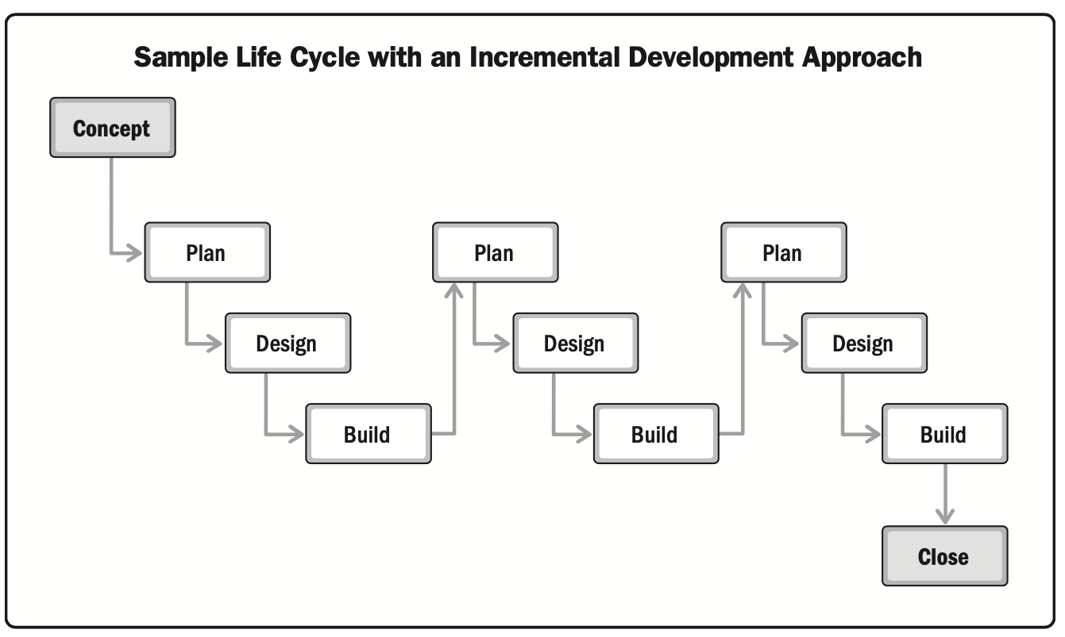
Sample Life Cycle with Incremental Development
The figure below has 3 iterations.
  Each subsequent iteration adds new functionality to the initial build
PMBOK V7 Agile Fig. 2-10

Slide 13
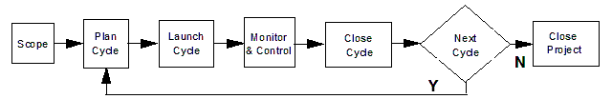
Agile Project Management (2)
Agile/Adaptive Life Cycle Model
Characteristics
Really very similar to incremental | Requirements not fully understood at outset
Each Agile incremental cycle helps uncover new requirements | Meaningful client involvement is essential
Fulfills the Agile Manifesto (see next section) | Customer satisfaction increases with early and continuous delivery of new value – this keeps the project sold
Incremental development is a development approach that slices the product into fully working slices that are called increments.

Slide 14
Software Engineering vs. Software Programming

Slide 15
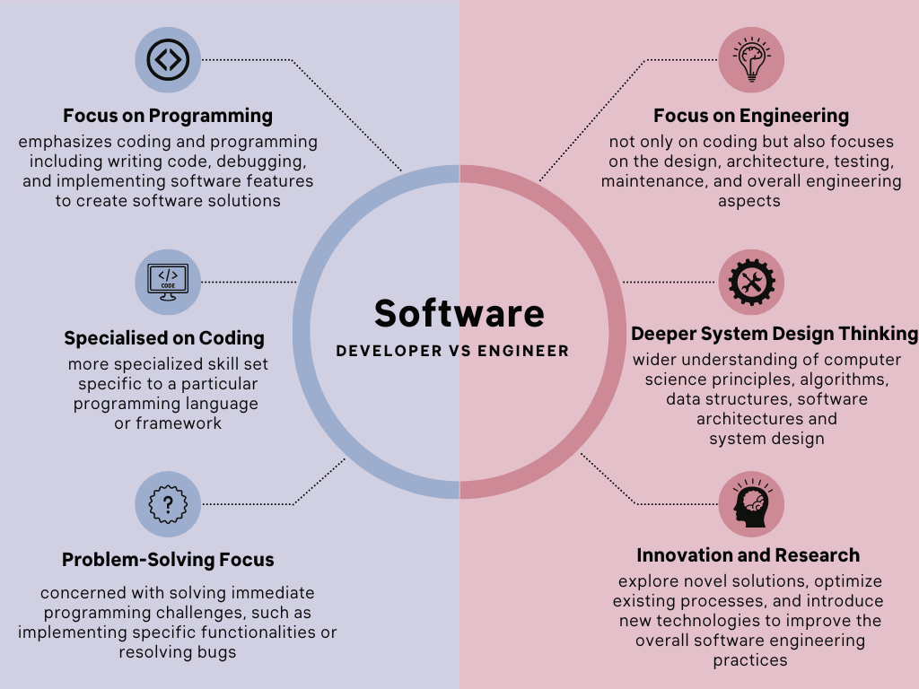
Software Engineers See The Bigger Picture

Slide 16
What Is A Software Engineer
Key Responsibilities of a Software Engineer:
  Design and develop software systems with scalability, security, and performance in mind.
  Create and maintain software architecture diagrams and documentation.
  Choose appropriate development tools and technologies for a project.
  Analyze system requirements and translate them into technical specifications.
  Oversee the development process, ensuring adherence to deadlines and quality standards.
  Collaborate with stakeholders, including developers, testers, and clients.
Skills for Software Engineers:
  Software Design Patterns and Architecture
  Algorithms and Data Structures
  System Design and Analysis
  Software Development Methodologies (e.g., Agile, Waterfall)
  Database Management Systems
  Strong Collaboration and Communication Skills
  All of the skills mentioned for Software Developers

Slide 17
Considerations In Software Engineering (1)
There are many aspects to consider in the design of software. The importance of each should reflect the goals and expectations to which the software is being created. The extent to which these factors are important impacts the overall cost of the software
Abstraction
  Hiding complex implementation details behind simple interfaces or APIs.
Compatibility
  The software is able to operate with other products that are designed for interoperability with another product. For example, a piece of software may be backward-compatible with an older version of itself.
Cost and Time
  Contractual requirements
  Internal dependencies
  Market timing
Coupling & Cohesion
  Coupling: Degree of dependency between modules. Low coupling is ideal — changes in one module minimally impact others.
  Cohesion: How closely related a module’s responsibilities are. High cohesion is desirable — each module has a clear, focused purpose.
Extensibility
  New capabilities can be added to the software without major changes to the underlying architecture.
Fault-tolerance and Robustness
  The software is resistant to and able to recover from component failure.
  The software is able to operate under stress or tolerate unpredictable or invalid input. For example, it can be designed with resilience to low memory conditions.
Maintainability and Testability
  A measure of how easily bug fixes or functional modifications can be accomplished. High maintainability can be the product of modularity and extensibility.
  Designing software that can be easily verified with automated tests.
  Reduces bugs and regression issues
  Supports TDD (Test-Driven Development) and BDD (Behavior-Driven Development)

Slide 18
Considerations In Software Engineering (2)
Modularity
  Breaking the system into smaller, self-contained units or modules. Easier to maintain and test individual modules
  Supports parallel development by multiple teams
  The resulting software comprises well defined, independent components which leads to better maintainability.
Performance
  The software performs its tasks within a time-frame that is acceptable for the user
Portability
  The software should be usable across a number of different conditions and environments.
Reliability
  The software is able to perform a required function under stated conditions for a specified period of time.
  MTBF (Mean Time Between Failures): The average amount of time a system operates without a failure. Higher MTBF indicates higher reliability.
  MTTR (Mean Time to Repair): The average time it takes to recover from a failure.
Resource Utilization
  Remaining within required resource specifications including processor utilization, memory and storage
Scalability and Reusability
  Ability to grow and adapt the system as requirements evolve. Future-proofs the design
  The ability to use some or all of the aspects of the preexisting software in other projects with little to no modification.
  Supports adding new features without rewriting existing code
  The software adapts well to increasing data or added features or number of users.
Security
  The software is able to withstand and resist hostile acts and influences.
Usability
  The software user interface must be usable for its target user/audience.
  Include the end-users in your design

Slide 19
Good And Popular Software Design Practices

Slide 20
Designing Software – A Typical Interview Question
Students are often asked during interviews – “How would you go about designing software?”
Requirements drive the design
Are you part of a bigger system
  Must understand and define interfaces
  What is the environment – OS, languages used, etc. Must the SW run on multiple platforms
  Are there memory or other physical constraints
Who are the end users (if the software requires human interface
Must understand their sophistication
What are the security requirements
  How hardened must the system be
Are you operating in a classified environment
What are the performance and reliability requirements
  Performance, efficiency and energy use are again becoming significant design drivers.
  New data centers for AI are energy hogs
Are there time/schedule constraints
  Can the software be delivered in increments
Are there cost constraints?

Slide 21
Some Key Practices In Software Development That Are Widely Agreed Upon (1)
Good design and definition of interfaces
  Interfaces allow us to encapsulate and then hide implementation details
  Well-defined interfaces between software objects is important to ensure that the code is usable
Automated testing is something almost universally agreed upon as a laudable goal.
  Tools capture test scenarios for playback so that they can be run multiple times.
Continuous integration, as opposed to developing in silo branches and then having extensive merging efforts, is also largely viewed as a benefit.
  Helps find any problems or disconnects between developers early in the process
Use of object-oriented design patterns
  Software Patterns describe how to solve typical problems that appear in many application scenarios in similar ways. – An abstract class has patterns that may be applied to multiple child classes
  These patterns can be seen as abstracted knowledge, that guides you in better solving your concrete problems
  For instance, all polygons have their perimeters calculated in a similar way.
  A more complex example – all cars start in a similar way.

Slide 22
Some Key Practices In Software Development That Are Widely Agreed Upon (2)
Code reviews are widely considered to be indispensable ways of promoting code quality.
  Usually done by peers as well as management to ensure that software is correct and meeting requirements
  Avoids fudging by programmers
Pair programming takes code reviews to the next level and has development performed in a constant state of review.
  Two persons teams continuously review and consult on each other’s code.
  Also provides backup in case of sickness, person switching jobs, …
One click, automated builds are considered an important goal for most organizations
  Eliminates the practice of having someone labor for half a day to get the software into a deployable state.
Low complexity makes the code much easier to test and maintain
  High complexity in code geometrically increases the number of tests
  The higher the complexity the more difficult it is to maintain the code
Good documentation is essential unless you want to own the same piece of code for its entire lifetime
  Need to be able to turn over code to a new developer or maintainer

Slide 23
Good Software Development
Writing good software is much more than sitting down and starting to code
  You need a methodology
  You need a structure
  You need to thoroughly test
    Every loop and branch must be thoroughly tested
    Handing in software that compiles but then doesn’t produce correct results is not really acceptable
  You need to strive towards simplicity
    This makes testing easier
  You need to refactor on a regular basis
    Refactoring is improving the software without adding new functionality
    Improvements can include modernizing the code, performance improvement, bug fixes, etc.
    Usually incorporated in interim releases
  You need well-documented software (see reference SoftwareDocumentation.pdf)
    You must document all logic, parameters, and test results
  You would like to develop reusable software whenever possible
    This requires data-driven software that can serve multiple similar purposes
    As we will see this also includes code parameterization

Slide 24
Good Basic Software Development Practices
Build the framework of classes first using UML class diagrams.
Keep code simple
  This means that you don’t want to nest too deeply.
Compile each class as you write it.
Write data driven software
  If all the data is hardcoded the software isn’t very useful.
  Data may be input from either the terminal or from files, dependent on instructions in the homework
    I usually provide the answers when you test with my inputs
Test thoroughly, first by unit, and then for the program as a whole.
  Start building test matrices.
Document, especially the external interfaces
Review and refactor the software to improve the code.

Slide 25
Good Practices For Software Coding and Testing

Slide 26
Good Coding Practices For Java Programmers (1)
1. Defining and Adhering to Naming Conventions
Before writing any code you should specify a set of naming conventions for your Java (or other) project, such as how to name classes and interfaces, how to name methods, how to name variables, how to name constants, etc. These conventions must be obeyed by all programmers in your team.
According to Robert Martin (the author of Clean Code), an identifier (a class, a method, and a variable) should have the following characteristics:
  Self-explanatory: a name must reveal its intention so everyone can understand and change the code easily. For example the names daysToExpire or inputText do reveal their intention clearly.
    If a name requires a comment to describe itself, then the name is not self-explanatory.
  Meaningful distinctions
    If names must be different, then they should also mean something different. For example, the names a1 and a2 have a meaningless distinction; while the names source and destination may be meaningful distinction.
  Pronounceable - Names should be pronounceable as naturally as spoken language because we are humans - very good at words.

Slide 27
Good Coding Practices For Java Programmers (2)
Here are some general naming rules:
Class and interface names should be nouns, starting with an uppercase letter.
  For example: Student, Car, Rectangle, Painter, etc.
  Don’t call any class Main – despite what some tool might do
    If you do there will be a deduction of several points in the homework
Variable names should be nouns, starting with a lowercase letter.
  For example: number, counter, birthday, gender, etc.
Method names should be verbs, starting with a lowercase letter.
  For example: run, start, stop, execute, etc.
Constant names should have all UPPERCASE letters and words are separated by underscores. For example: MAX_SIZE, MIN_WIDTH, MIN_HEIGHT, etc.
Using camelCase notation for variable and method names.
  For example: studentManager, carController, numberOfStudents, runAnalysis,
  A good reference for naming conventions is an Oracle’s publication: Java Code Conventions. Build your own naming conventions using this document.
Remember, naming is very important in programming as we name everything from classes to interfaces to methods to variables to constants, etc.
  So do not write code just to satisfy the compiler, write code so that it is readable and can be understood by humans - for yourself, for your teammates, and for other guys who end up maintaining your project.

Slide 28
Good Coding Practices For Java Programmers (3)
2. Ordering Class Members by Scopes
The best practice to organize member variables of a class by their scopes from most restrictive to least restrictive.
  That means we should sort the members by the visibility of the access modifiers: private, default (package), protected, and public. And each group separated by a blank line.
  For example, the following members declaration looks quite messy:
  public class StudentManager
  {
  protected List<Student> listStudents;
  public int numberOfStudents;
  private String errorMessage;
  float rowHeight;
  float columnWidth;
  protected String[] columnNames;
  private int numberOfRows;
  private int numberOfColumns;
  public String title;
  }
  This is better:
  public class StudentManager
  {
  private String errorMessage;
  private int numberOfColumns;
  private int numberOfRows;
  private float columnWidth;
  private float rowHeight;
  protected String[] columnNames;
  protected List<Student> listStudents;
  public int numberOfStudents;
  public String title;
  }

Slide 29
Good Coding Practices For Java Programmers (4)
3. Class Member Instance Variables Should Be Private
We should minimize the accessibility of class members fields (the instance variables)
  That means we should use the lowest possible access modifier (hence the private modifier) to protect the fields. This practice is recommended in order to enforce information hiding or encapsulation in software design.
Use mutator methods to change these variables.
  The added benefit is that you check for the validity of a value only once
4. Avoid Empty Catch Blocks
It’s a very bad habit to leave catch blocks empty, as when the exception is caught by the empty catch block, the program fails in silence, which makes debugging harder.
5. Using StringBuilder or StringBuffer (for parallel/multithreaded programming) instead of String Concatenation
In Java, an immutable class is a class whose state cannot be changed once an object of that class is created. This means that the values of its instance variables cannot be modified after initialization.
The String class is immutable, so each time we do a concatenation we create a whole new object
  This is not the case with StringBuilder objects

Slide 30
Good Coding Practices For Java Programmers (5)
6. Use enum or Constant class instead of Constant interface
It’s a very bad idea to create an interface which is solely for declaring some constants without any methods. Here’s such a poor interface (some of the qualifiers are not necessary, but we will discuss that in the Lesson 3):
  public interface Color
  {
  public static final int RED = 0xff0000;
  public static final int BLACK = 0x000000;
  public static final int WHITE = 0xffffff;
  }
This is because the purpose of interfaces is for inheritance and polymorphism, not for static variables. So the best practice recommends us to use an enum instead. For example:
  public enum Color {BLACK, WHITE, RED}
7. Avoid Redundant Initialization (0-false-null char - null)
It’s unnecessary to initialize member variables to the following values: 0 (for primitive numerics), false (for Boolean), null character (for char) and null (for objects).
  Just as is the case with arrays these values are the default initialization values of member variables in Java.
  Of course, local variables in general must be assigned a value(No defaults).
  Arrays have all cells initialized to their types default
    Primitives to 0, 0.0 , false or for char the null character
    All cells of any class type are initialized to Null

Slide 31
Good Coding Practices For Java Programmers (6)
8. Use Interface References to Collections
When declaring collection objects, references to the objects should be as generic as possible.
  This is to maximize the flexibility and protect the code from possible changes in the underlying collection implementations class.
  It allows us to use the methods of the interface in any of the classes implementing the Interface
  That means we should declare collection objects using their interfaces List, Set, Map, Queue and Deque.
  We will demonstrate this when we discuss Generics and then the Collection Framework
  List <MyClass> myNewlist = new ArrayList<>();
9. Avoid Using for Loops With Indexes
Don’t use a for loop with an index (or counter) variable if you can replace it with the enhanced for loop, an iterator, or forEach (since Java 8).
  It’s because the index variable is error-prone, as we may alter it incidentally in the loop’s body, or we may start the index from 1 instead of 0.
Remember: Using good programming practices will help you win that job you really want.

Slide 32
Software Testing Methodologies

Slide 33
Good Practices For Unit Testing (1)
Test only one code unit at a time
  When we try to test a unit of code, this unit can have multiple use cases. We should always test each use case in a separate test case.
  For example, if we are writing the test case for a function which is supposed to take two parameters and should return a value after doing some processing, then different use cases might be:
    First parameter can be null. It should throw Invalid parameter exception.
    Second parameter can be null. It should throw Invalid parameter exception.
    Both can be null. It should throw Invalid parameter exception.
    Finally, test the valid output of function. It should return valid pre-determined output.
    This helps when you do some code changes or do refactoring then to test that functionality has not broken, running the test cases should be enough. Also, if you change any behavior then you need to change single or least number of test cases.
Make each test independent of all the others
  Do not make a chain of unit test cases. It will prevent you from identifying the root cause of test case failures and you will have to debug the code.
  Also, it creates dependency, which means that changing one test case then you need to make changes in multiple test cases unnecessarily.

Slide 34
Good Practices For Unit Testing (2)
Emulate all external services and states
  Otherwise, behavior in those external services overlaps multiple tests, and state data means that different unit tests can influence each other’s outcome.
  You’ve definitely taken a wrong turn if you have to run your tests in a specific order, or if they only work when your database or network connection is active.
  This is important because you would not love to debug the test cases which are actually failing due to bugs in some external system.
  Note: You will have a chance to test for these interfacing problems during integration testing

Slide 35
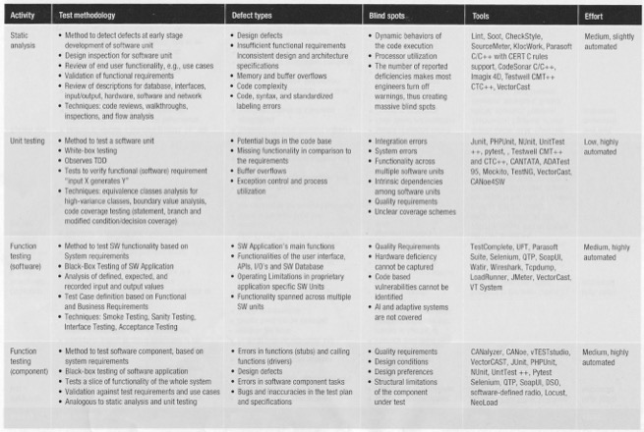
Testing Methodologies (1)
See The TestingTable.PDF Version For Easier Viewing

Slide 36
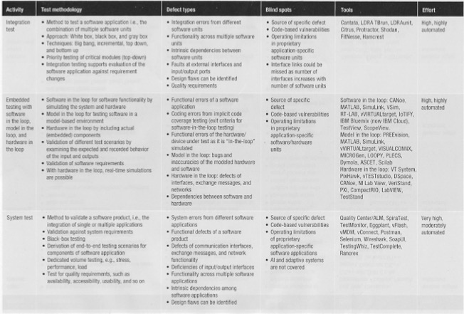
Testing Methodologies (2)

Slide 37
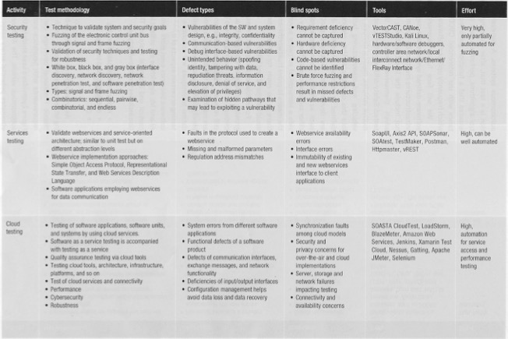
Testing Methodologies (3)

Slide 38
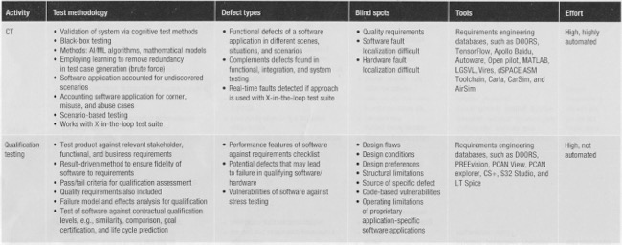
Testing Methodologies (4)

Slide 39
Static Program Analysis

Slide 40
Static Program Analysis
Static Program Analysis consists of the programs or algorithms designed to extract facts from another program’s source code without executing it
  This is distinct from dynamic analysis which extracts facts from a program as it runs, and model checking which verifies the correctness of a separate external specification of the program
Due to the complexity of software development, and the problems with ever increasing bug and security issues, these tools are necessary
Static analysis is generally good at finding coding issues such as:
  Programming errors (Think compilers)
    They also issue warnings about potential issues
  Coding standard violations
  Undefined values
  Syntax violations
  Security vulnerabilities
  Weaknesses in source code that could lead to buffer overflows -- a common software vulnerability.
  Inaccessible/unused code (dead code)

Slide 41
How Is Static Program Analysis Done
The static analysis process is relatively simple if it's automated.
  Generally, static analysis occurs before software testing in early development. In the DevOps development practice, it will occur in the create phases.
Once the code is written, a static code analyzer should be run to review the code.
  It will check against defined coding rules from standards or custom predefined rules.
  Once the code is run through the static code analyzer, the analyzer will have identified whether or not the code complies with the set rules.
  It is sometimes possible for the software to flag false positives, so it is important for someone to go through and dismiss any.
  Once false positives are waived, developers can begin to fix any apparent mistakes, generally starting from the most critical ones. Once the code issues are resolved, the code can move on to testing through execution.
Without having code testing tools, static analysis will take a lot of work, since humans will have to review the code and figure out how it will behave in runtime environments.
  Therefore, it's a good idea to find a tool that automates the process.
  Getting rid of any lengthy processes will make for a more efficient work environment

Slide 42
Types Of Static Program Analysis
There are several static analysis methods an organization could use, which include:
Control analysis
  Focuses on the control flow in a calling structure. For example, a control flow could be a process, function, method or in a subroutine.
Data analysis
  Makes sure defined data is properly used while also making sure data objects are properly operating.
Fault/failure analysis
  Analyzes faults and failures in model components.
Interface analysis
  Verifies simulations to check the code and makes sure the interface fits into the model and simulation.
Complexity Analysis (described in next section)
  Evaluates the complexity of the code and gives it a score
In general, static analysis can be broken into formal, cosmetic, design properties, error checking and predictive categories.
  Formal meaning if the code is correct
  Cosmetic meaning if the code syncs up with style standards
  Design properties meaning the level of complexities
  Error checking which looks for code violations
  Predictive, which asks how code will behave when run.

Slide 43
Benefits and Drawbacks Of Static Program Analysis
Benefits
  It can evaluate all the code in an application, increasing code quality.
  It provides speed in using automated tools compared to manual code review
  Paired with normal testing methods, static testing allows for more depth into debugging code.
  Automated tools are less prone to human error.
  It will increase the likelihood of finding vulnerabilities in the code, increasing web or application security.
  It can be done in an offline development environment.
Drawbacks
  False positives can be detected.
  A tool might not indicate what the defect is if there is a defect in the code.
  Not all coding rules can always be followed, like rules that need external documentation.
  Static analysis may take more time than comparable methods.
  Static analysis can't detect how a function will execute.
  System and third-party libraries may not be able to be analyzed.

Slide 44
Software Complexity

Slide 45
Cyclomatic Software Complexity (1)
Every program encompasses statements to execute in order to perform some task and other decision-making statements that decide, what statements need to be executed.
  These decision-making constructs change the flow of the program.
If we compare two programs of the same size, the one with more decision-making statements will be more complex as the control of program jumps frequently.
In 1976, McCabe proposed the Cyclomatic Complexity Measure to quantify complexity of a given software.
  It is a quantitative measure of the number of linearly independent paths through program's source code
  It is graph driven model that is based on decision-making constructs of program such as if-else, do-while, repeat-until, switch-case and goto statements.
  In normal terms, the cyclomatic complexity measure tells how complex your code is.
Process to make a flow control graph:
  Break program in smaller blocks, delimited by decision-making constructs.
  Create nodes representing each of these blocks.
  Connect nodes as follows:
    If control can branch from block i to block j
      Draw an arc
    Optional: From each exit node to entry node
      Draw an arc

Slide 46
Cyclomatic Software Complexity (2)
Good software design keeps the complexity of any method low, limiting the levels of nesting by creating and invoking new methods.
  Note: The government has strong limits on the level of complexity of any individual piece of software that it will accept in a contract deliverable.
  These standards have filtered into commercial standards
With lowered complexity you may require more methods
  Therefore, good and complete documentation of each method, as well as each class, it extremely important
See SW Complexity SEI Carnegie Mellon.pdf in references

Slide 47
Importance Of Cyclomatic Complexity
It helps in determining the software quality.
It is an important indicator of program code’s readability, maintainability and portability.
It helps the developers and testers to determine independent path executions.
It helps to focus more on the uncovered paths.
It evaluates the risk associated with the application or program.
It provides assurance to the developers that all the paths have been tested at least once.

Slide 48
Calculating Cyclomatic Software Complexity
Mathematically, the cyclomatic complexity of a structured program is defined with reference to the control flow graph of the program, a directed graph containing the basic blocks of the program, with an edge between two basic blocks if control may pass from the first to the second. The complexity M is then defined as
  M = E − N + 2P,
  where
  E = the number of edges of the graph.
  N = the number of nodes of the graph.
  P = represents number of nodes that have exit points in the control flow graph. (or often considered as the number of connected components)
Key Points:
  It is the maximum number of independent paths through the program code.
  It depends only on the number of decisions in the program code.
  Insertion or deletion of functional statements from the code does not affect its cyclomatic complexity.
  It is always greater than or equal to 1.

Slide 49
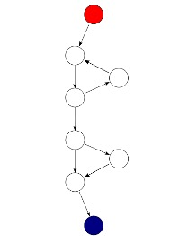
Example Of Complexity Calculation
A control flow graph of a simple program.
  The program begins executing at the red node, then enters a loop (group of three nodes immediately below the red node).
  On exiting the loop, there is a conditional statement (group below the loop), and finally the program exits at the blue node.
  This graph has 9 edges, 8 nodes, and 1 exit point, so the cyclomatic complexity of the program is
  9 - 8 + 2*1 = 3
From: https://en.wikipedia.org/wiki/Cyclomatic_complexity

Slide 50
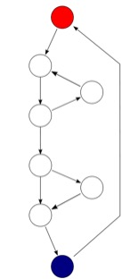
Alternate Formula (optional)
An alternative formulation is to use a graph in which each exit point is connected back to the entry point.
  In this case, the graph is strongly connected, and the cyclomatic complexity of the program is equal to the cyclomatic number of its graph (also known as the first Betti number), which is defined as
    M = E − N + P.
This may be seen as calculating the number of linearly independent cycles that exist in the graph, i.e. those cycles that do not contain other cycles within themselves.
  Note that because each exit point loops back to the entry point, there is at least one such cycle for each exit point.
  If there was more than one exit point we’d need an extra edge back to the start for each one
  M = 10 -8 + 1 = 3
Just stick with the first formula
From: https://en.wikipedia.org/wiki/Cyclomatic_complexity

Slide 51
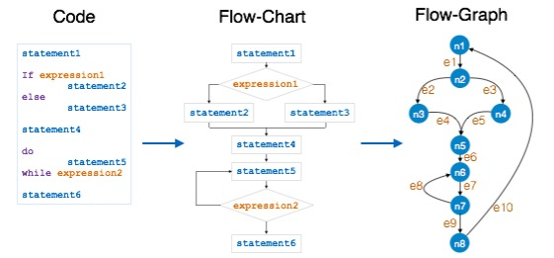
Another Cyclomatic Complexity Example
In the above example:
e = 10
n=8
Cyclomatic Complexity = 10 - 8 + 1 =3 (using alternate formulation with the e10 connecting arc)
Or
M = 9 -8 +2*1 = 3 (Using basic formula)

Slide 52
Levels Of Cyclomatic Complexity
Cyclomatic Complexity | Meaning
1 – 10 | Structured and Well Written Code High Testability Less Cost and Effort
10 – 20 | Complex Code Medium Testability Medium Cost and Effort
20 – 40 | Very Complex Code Low Testability High Cost and Effort
> 40 | Highly Complex Code Not at all Testable Very High Cost and Effort Much Harder to Maintain

